Slide 1
Cell Pattern

Slide 2
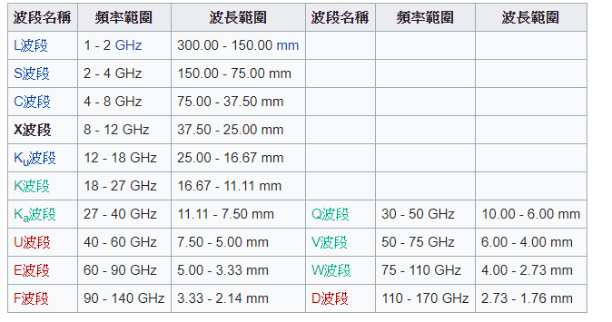
Introduction
Space and HAPS systems typically feature larger cells compared to cellular networks. In addition, the cells may be moving (without a fixed earth reference point) in case of NGSO (Non Geostationary Satellite Orbit) satellite or HAPS system.
These large cells especially at low operational elevation angles will create a significant differential propagation delay between a UE at cell centre and UE at cell edge and the ratio of the differential increases as the altitude of the satellite and HAPS decreases. In other words, the ratio between propagation delays at cell centre and cell edge is likely to be higher in the context of HAPS as compared to geostationary satellite systems.
Notes:
跟cellular network相比，Space & HAPS系統的cells比較大並且會移動。

Slide 3



高仰角
低仰角
70°
45°
Notes:
Cell的中心UE與邊緣UE的propagation delay差異明顯(特別在低仰角時)，
並且其差比隨衛星與HAPS的高度增加

Slide 4
Near-far effect
The differential delay due to large cell size may create near far effect between UEs during the initial access procedure when the UEs positions are not known. This may require an extended acquisition window to improve performance.
Notes:
在UEs的位置不知道的時候，在大的cell裡，UEs在進行initial access procedure時會引發near-far effect，
在CDMA系統下，有兩個UE ，一近一遠，若兩個UE以同樣功率進行傳輸，基地台收到近UE的功率必大於遠UE的功率，這時對於近UE來說遠UE的信號就是噪聲，遠UE的信造比遠小於近UE，代表遠UE的通訊就會很困難，這時若遠UE想跟基地台保持通信，必須加大發射功率，這時近UE的信噪比就會下降，但為了能通訊，近UE又會加大發射功率，那互相較勁的結果就是最後只有近UE能夠與基地台通訊，那根據維基百科寫的，他說簡而言之，near-far effect就是過濾掉若信號質量通信的過程。
那一班來說要解決near-far effect就是近的UE用低發射功率，讓大家的信噪比相差不多，但是當近UE加大功率時，代表其他遠UE也都要加大功率。
這可能需要擴展的採集窗口以提高性能。??

Slide 5
Attention:
The mobility management should accommodate the specific cell patterns (size and position) of NTN networks. Moreover, cells in the non-terrestrial network may cross borders between countries.
cells的識別方法
追蹤與位置區域的設計
漫遊
或基於位置的服務
Notes:
Mobility management應要能容納NTN網路中的cell patterns(因為有不同大小且會移動的cells) 另外要注意cell可能會跨國界
那因為有這些特性所以要考慮的有:

Slide 6
Furthermore, NGSO and HAPS systems generate cells which move around. This causes hand-over to occur not only for mobile units but also for fixed UEs. However, the hand-over caused by such NTN may be anticipated, by exploiting trajectory models such as satellite ephemeris.
Paging and Hand-over procedures should be adapted to take into account the relative motion of the cell pattern with respect to the tracking area. Further analysis on tracking area design may need to be carried out. Mobility management is also to be considered.
Notes:
因為NGSO與HAPS產生的cell會移動，因此在hand-over上不僅僅考慮移動的UEs，連固定位置的UEs都必須考慮會有hand-over的問題。
paging和hand-over應考慮到cell pattern相對於tracking area的運動。 可能需要對tracking area設計進行進一步分析

Slide 7
Thank you

